Slide 1
Project SHOWCASE
DSCI-6007-03:TEAM 10

Slide 2

Optimizing Business Operations Through a Scalable Data Pipeline
We aim to tackle operational inefficiencies in businesses, leading to financial losses and reduced productivity. Our solution involves building a scalable cloud-based data pipeline to diagnose and address these inefficiencies, leveraging AWS cloud services to ingest, process, and analyze data. This will generate actionable insights to optimize various aspects of business operations, integrating both real-time streaming and historical data for continuous monitoring and optimization.

Slide 3




Meet Team 10
Nischal Subedi
Abhigya Malla
Ronik Karki
Team Leader: Manages workflow, ensures deadlines are met.
Data Engineer: Designs and develops the ETL pipeline.
Visualization & Storytelling Lead: Develops dashboards and communicates insights.
Our team comprises individuals with expertise in various domains, including team leadership, data engineering, and data visualization. Nischal Subedi leads the team, ensuring smooth workflow and adherence to deadlines. Abhigya Malla is responsible for designing and developing the ETL pipeline. Ronik Karki focuses on developing dashboards and effectively communicating insights through data visualization and storytelling.

Slide 4
The Challenge: Operational Inefficiencies
1
Costly Wastage
2
Missed Opportunities
3
Reduced Productivity
Operational inefficiencies can lead to up to 30% of a company’s annual costs being wasted due to poor data management and outdated processes.
Slow response times and lack of actionable insights prevent businesses from adapting quickly to market changes, leading to 15-20% revenue loss.
Inefficient systems can cause employees to waste time on manual tasks, resulting in a 20% increase in operational costs.
The key problem we are solving is operational inefficiencies in businesses that lead to significant financial losses, resource wastage, and reduced productivity. Many organizations face challenges in identifying, diagnosing, and addressing inefficiencies across various operations such as supply chain, workforce management, inventory control, and resource allocation. This problem is prevalent across multiple industries, including manufacturing, retail, logistics, and healthcare.

Slide 5
Our Solution: A Scalable Data Pipeline
Solution Overview
Data Needed
Data Sources
Building a scalable cloud-based data pipeline designed to diagnose and address operational inefficiencies that lead to business losses.
Operational data (performance metrics) and transactional data (sales, expenses, inventory management) are necessary for diagnosing inefficiencies.
Internal business systems (company databases, ERP software) and external data sources (market data, social media feeds) will be utilized.
Our solution involves building a scalable cloud-based data pipeline designed to diagnose and address operational inefficiencies that lead to business losses. The pipeline will leverage a combination of AWS cloud services to ingest, process, and analyze data, generating actionable insights to optimize various aspects of business operations. We aim to integrate both real-time streaming and historical data to enable continuous monitoring and optimization of business processes.

Slide 6
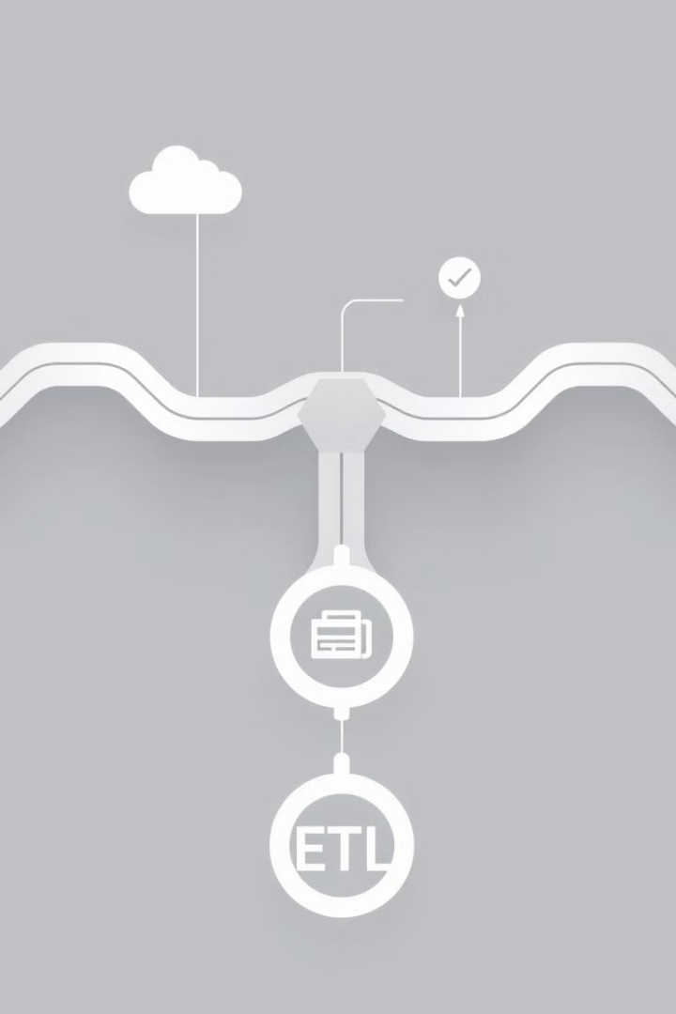



ETL Pipeline Overview (CRISP-DM)
Extract
Gather data from ERP systems and sales databases using AWS Glue.
Transform
Clean and preprocess the data using AWS Glue.
Load
Store processed data in Amazon S3.
The ETL pipeline aligns with the CRISP-DM methodology, ensuring that data is collected, prepared, and stored effectively for modeling and evaluation. We extract data from various sources, transform it by cleaning and preprocessing, and then load it into scalable storage solutions. This pipeline ensures that data is collected, prepared, and stored effectively for modeling and evaluation.

Slide 7






CRISP-DM Methodology
Business Understanding
1
Data Understanding
2
6
Deployment
Data Preparation
3
5
4
Evaluation
Modeling
Our project follows the CRISP-DM methodology, starting with business understanding and data understanding. We then move to data preparation, modeling, evaluation, and finally, deployment. This structured approach ensures that we address operational inefficiencies effectively and deliver a scalable solution. We apply machine learning models to identify operational inefficiencies and assess model performance using various metrics.

Slide 8
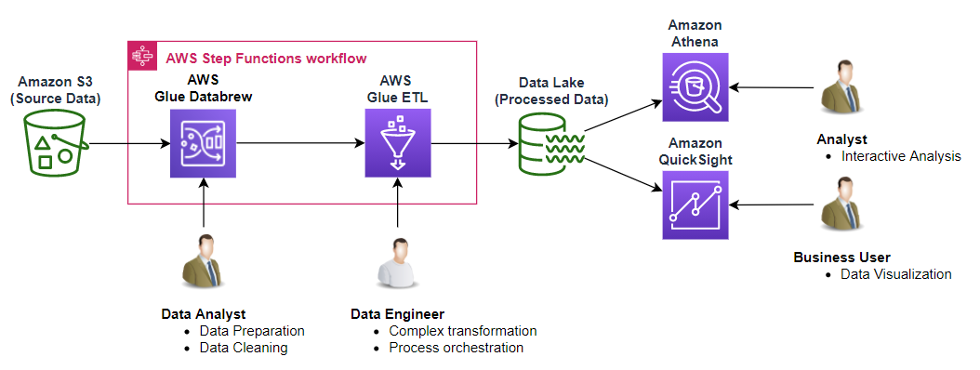
Architecture flow Diagram
The diagram outlines a comprehensive data workflow designed to optimize business operations using AWS services. It begins with Amazon S3 as the source for raw data ingestion, where operational and transactional data are collected. The data then flows into AWS Step Functions to orchestrate the workflow, ensuring seamless coordination between services. AWS Glue Data brew and AWS Glue ETL handle data preparation, cleaning, and transformation, addressing missing values, outliers, and complex transformations. The processed data is stored in the Data Layer (Amazon S3), making it accessible for analysis. Amazon Athena enables fast, serverless querying of this data, while Amazon QuickSight provides interactive analysis and visualization tools. Data Analysts focus on preparation and cleaning, while Data Engineers manage complex transformations and orchestration. This workflow supports real-time insights, helping businesses identify inefficiencies, optimize processes, and make data-driven decisions, aligning with the CRISP-DM methodology to deliver scalable, actionable results.

Slide 9

Expected Outcomes & Impact
Reduce Costs
Increase Productivity
Reduce operational costs by 15-20% within the first quarter.
Increase employee productivity by 10-15% by optimizing task assignments.
Enhance Decision-Making
Enhance decision-making speed through real-time data analysis.
We anticipate significant improvements in operational efficiency by identifying and addressing key inefficiencies in the business processes. By leveraging real-time data analysis and predictive modeling, we expect to reduce operational costs, increase employee productivity, and enhance decision-making speed. Businesses can apply the insights from our data pipeline in several key areas to drive improvements.

Slide 10

Next Steps & Call to Action
1
Data Collection
Begin gathering operational and transactional data from relevant sources.
2
Model Development
Finalize and deploy the predictive models to identify inefficiencies in real-time.
3
Deployment & Testing
Deploy the data pipeline in a test environment and perform validation and performance testing.
To recap, our project aims to diagnose and address operational inefficiencies in business operations that lead to unnecessary costs and reduced productivity. We encourage stakeholders to collaborate with us during the testing phase to provide feedback and fine-tune the solution. By engaging in our work, stakeholders can help ensure that the pipeline is aligned with the business’ needs and objectives.

Slide 11

Any Questions?

